Slide 1


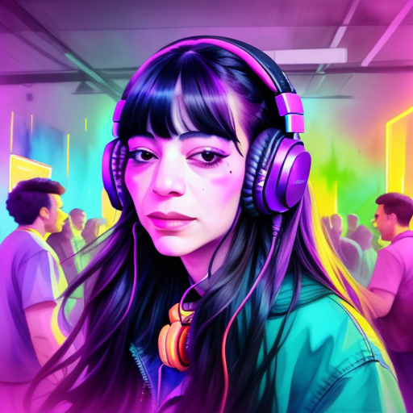
Personalization of Diffusion Models
Using 🧨Diffusers
X
Linoy Tsaban ML Engineer
Hugging Face
February 29th, 2024

Slide 2

Diffusion Models
Notes:
Diffusion models achieve success through iterative refinement of the diffusion process, starting from random noise and gradually improving over multiple steps until an output image is produced. The model estimates how to progress from the current input to a denoised version at each step, correcting errors made in earlier stages during subsequent updates. Training involves loading training images, adding varying amounts of noise, feeding them into the model, evaluating its denoising performance, and updating model weights accordingly. Generating new images with a trained model involves starting with random input and iteratively refining it through the model, with sampling methods aiming to streamline this process for efficient image generation.

Slide 3
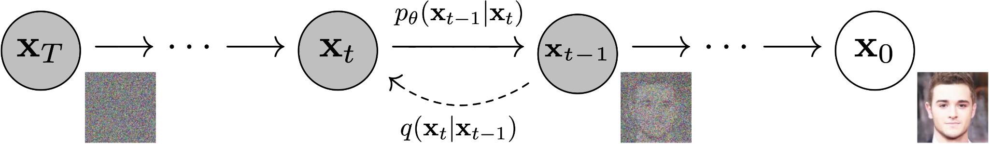
Diffusion Models
Notes:
Diffusion models achieve success through iterative refinement of the diffusion process, starting from random noise and gradually improving over multiple steps until an output image is produced. The model estimates how to progress from the current input to a denoised version at each step, correcting errors made in earlier stages during subsequent updates. Training involves loading training images, adding varying amounts of noise, feeding them into the model, evaluating its denoising performance, and updating model weights accordingly. Generating new images with a trained model involves starting with random input and iteratively refining it through the model, with sampling methods aiming to streamline this process for efficient image generation.

Slide 4
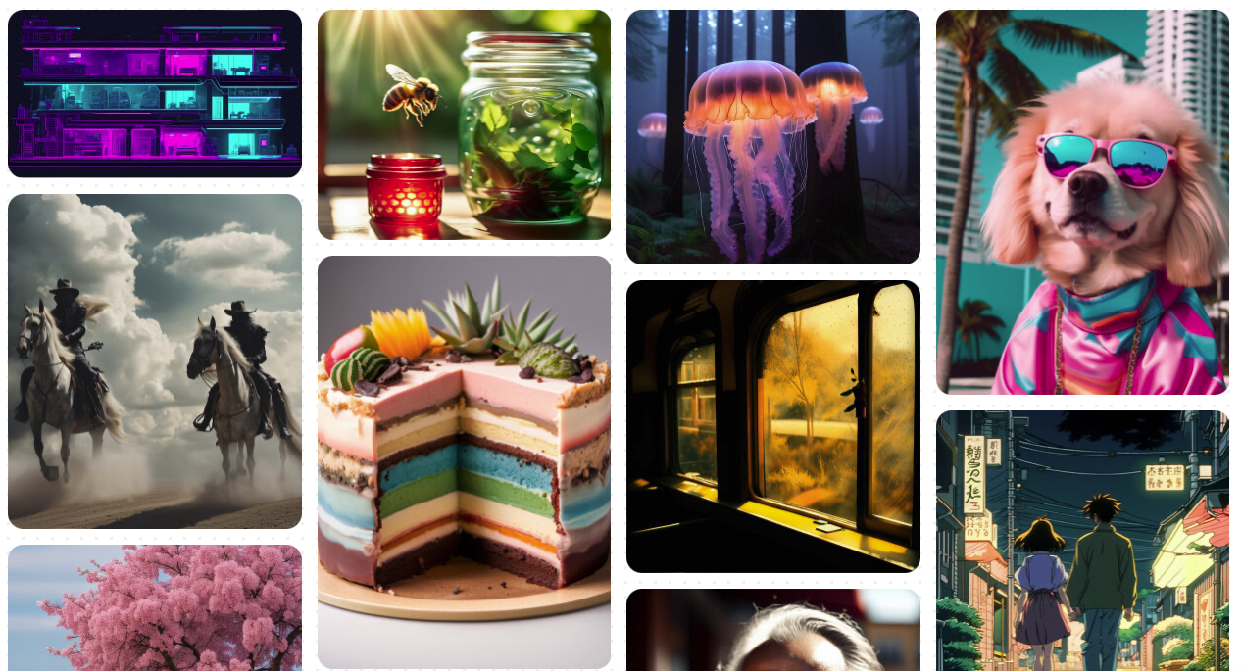
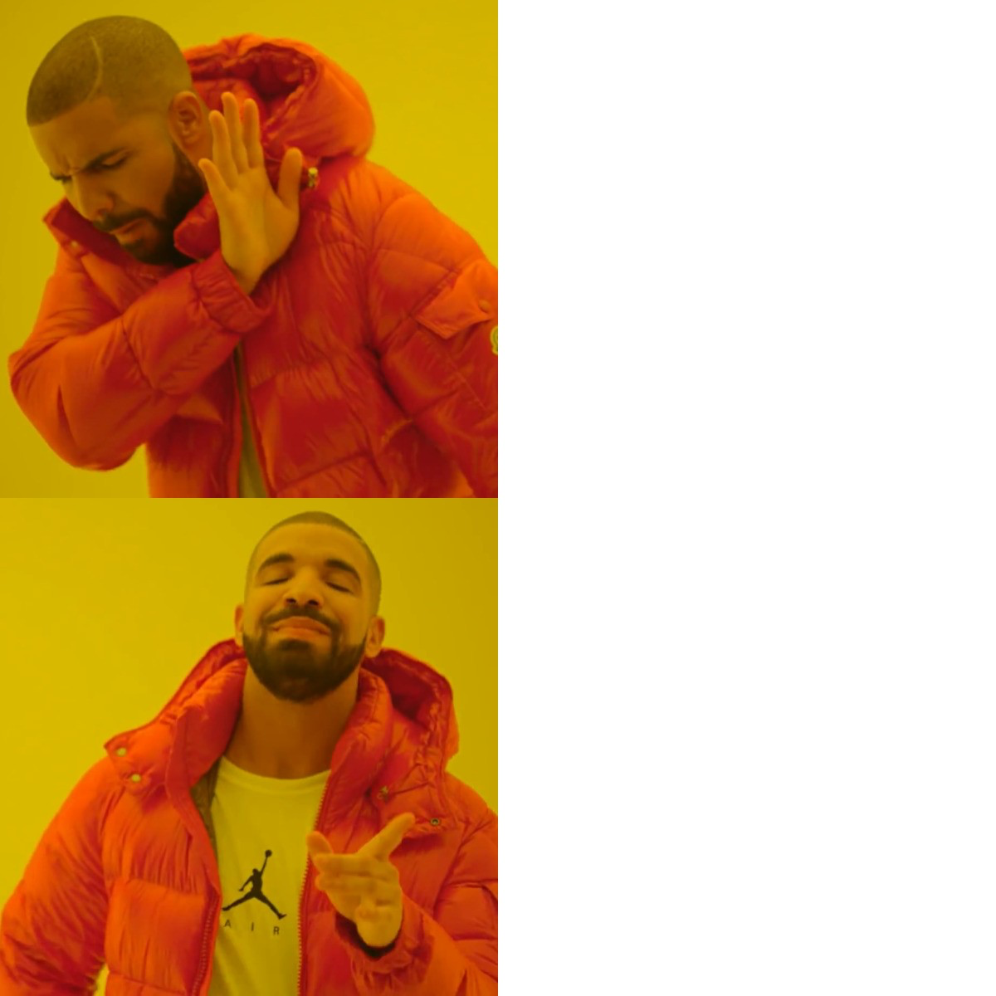
Stable Diffusion
Pixel space
Latent space
Notes:
First released in april of 2022 First to propose training DMs in the latent space of pretrained autoencoders, striking a balance between complexity reduction and detail preservation. This approach, termed latent diffusion models (LDMs), achieves state-of-the-art results in image inpainting, class-conditional image synthesis, and other tasks, while significantly reducing computational requirements compared to traditional pixel-based DMs. By introducing cross-attention layers, LDMs gain flexibility to handle various conditioning inputs, such as text or bounding boxes, enabling high-resolution synthesis in a more efficient manner.

Slide 5
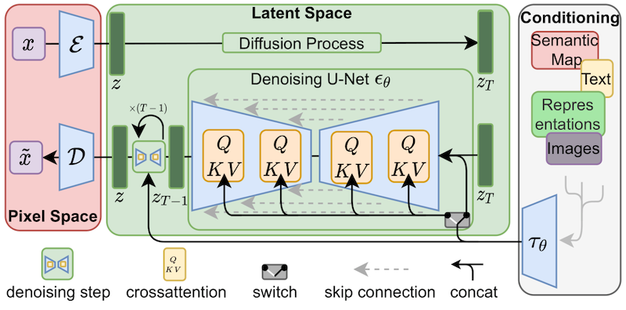
Stable Diffusion

Slide 6
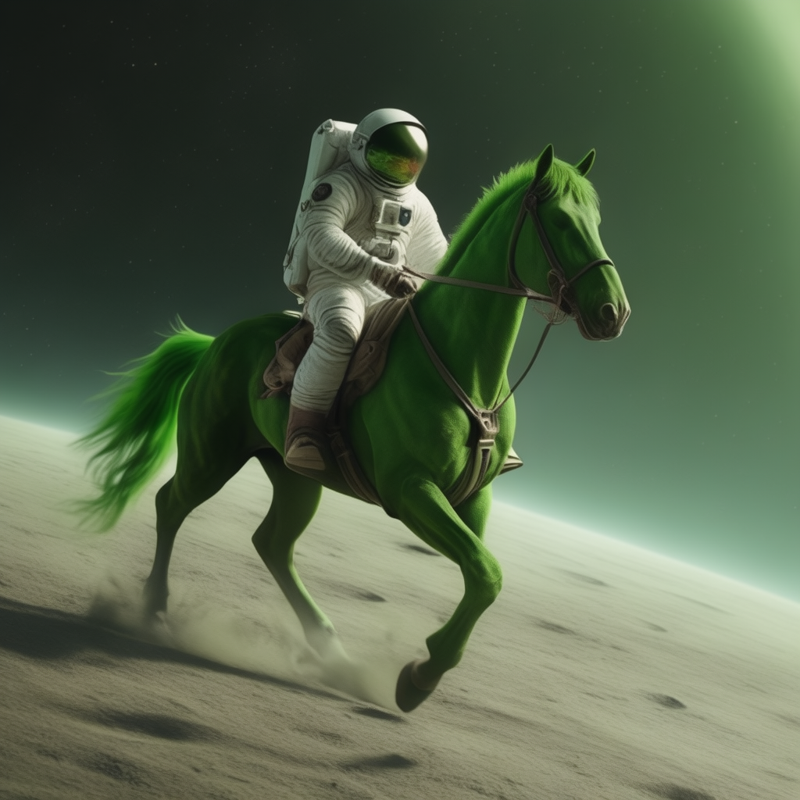
Latest Release - Stable Cascade
Click here to try it out!

Slide 7
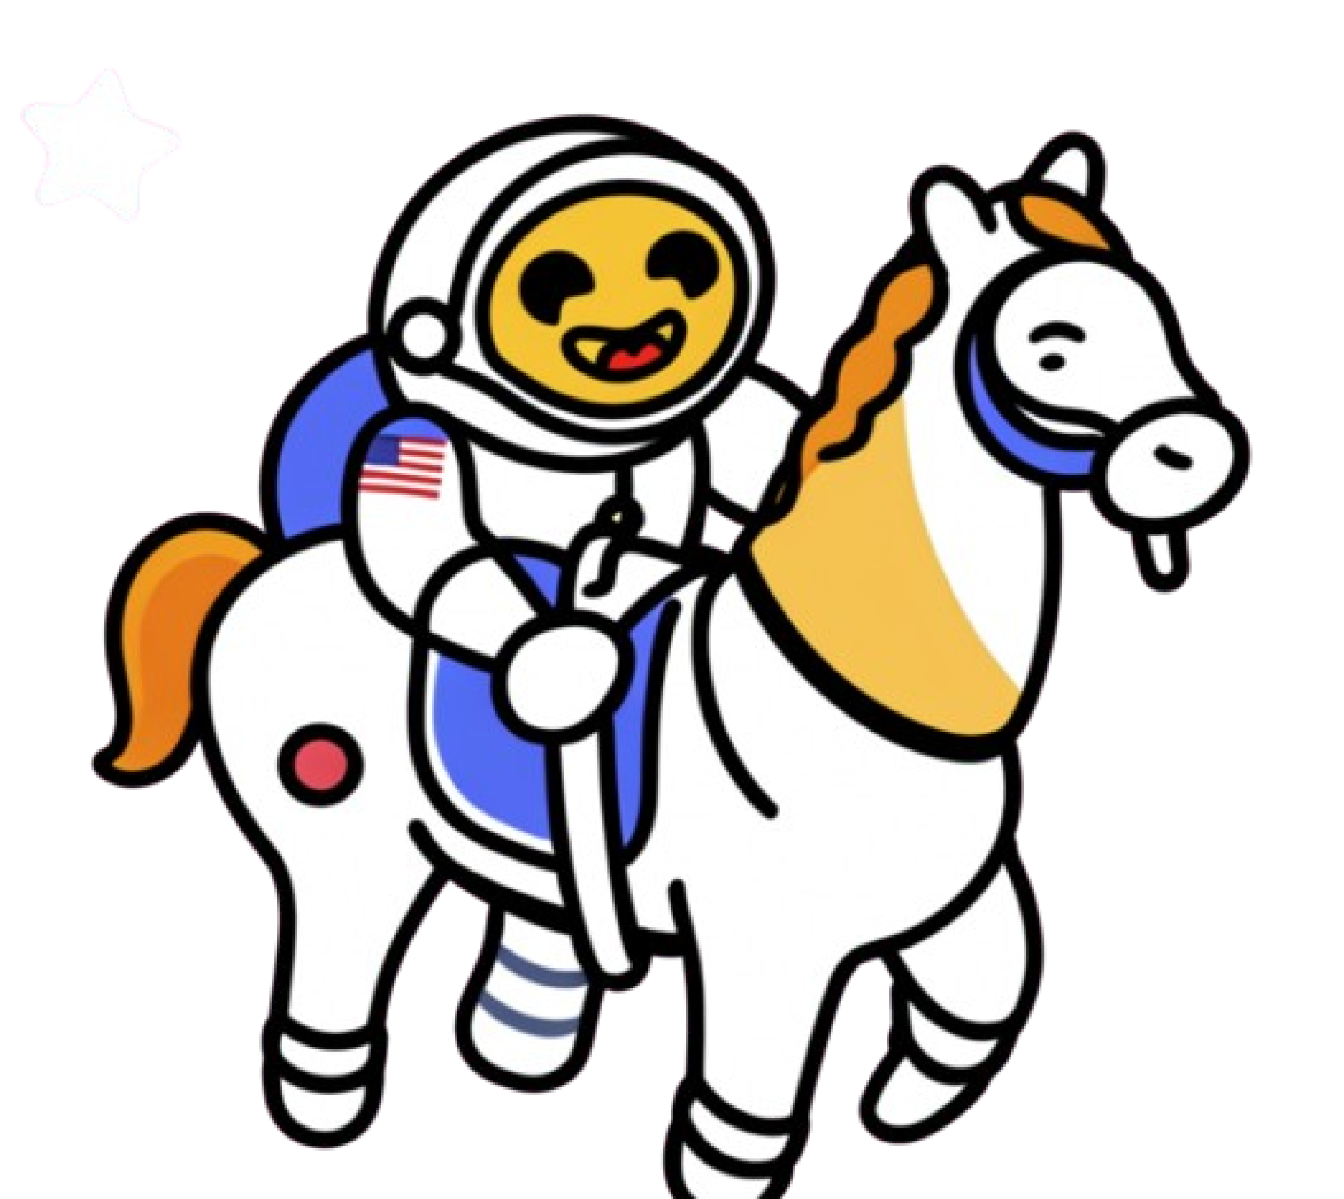
Personalization
What is
?
Usually*, refers to the process of teaching new concepts to a diffusion model by using specialized forms of fine-tuning.
E.g. Dreambooth, Textual Inversion, LoRA
*

Slide 8
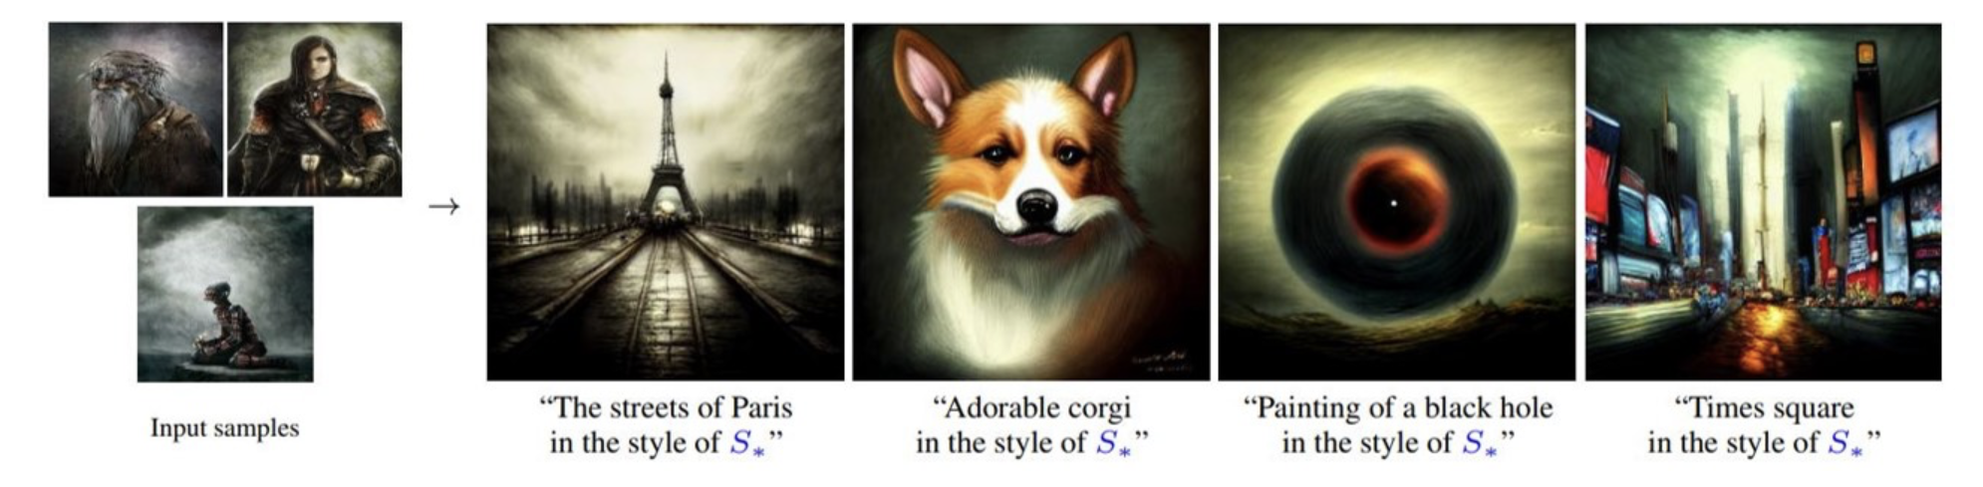
Textual Inversion
Textual Inversion
(Fine Tuning Technique)
When we teach a new concept to Stable Diffusion by finding new text embeddings that represent the concept. These embeddings are then linked to new pseudo-words, which can be incorporated into new sentences like any other word.
Gal, Rinon, et al. "An image is worth one word: Personalizing text-to-image generation using textual inversion."
Notes:
In the text-encoding stage of most text-to-image models, the first stage involves converting the prompt into a numerical representation. This is typically done by converting the words into tokens, each equivalent to an entry in the model's dictionary. These entries are then converted into an "embedding" - a continuous vector representation for the specific token. These embeddings are usually learned as part of the training process. In our work, we find new embeddings that represent specific, user-provided visual concepts. These embeddings are then linked to new pseudo-words, which can be incorporated into new sentences like any other word. In a sense, we are performing inversion into the text-embedding space of the frozen model. We're calling the process 'Textual Inversion'.

Slide 9
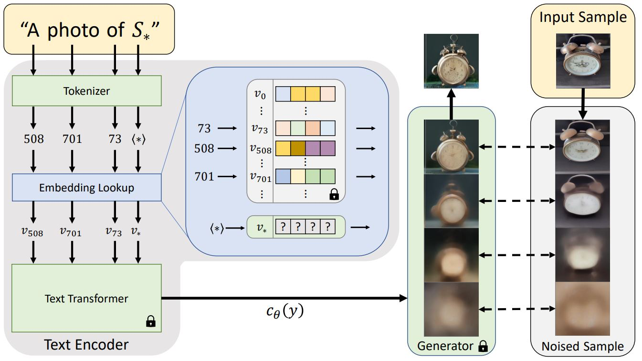
Textual Inversion
Gal, Rinon, et al. "An image is worth one word: Personalizing text-to-image generation using textual inversion."
Notes:
explores how text-to-image models can be utilized to generate specific, unique concepts or modify existing ones based on natural language prompts. By representing user-provided concepts through embeddings in a text-to-image model, generated images can be guided by intuitive language prompts, such as turning a cat into a painting or envisioning a new product inspired by a favorite toy, using only a few reference images. Through comparison with various baselines, the approach proves more effective in faithfully portraying concepts across different applications and tasks.

Slide 10
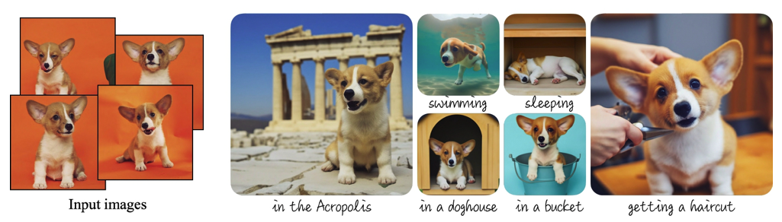
Dreambooth
Dreambooth
(Fine Tuning Technique)
When we teach a new concept to Stable Diffusion by fine tuning on 3-5 input images paired with a text prompt containing a unique identifier and the name of the class the subject belongs to (e.g., "A photo of a [T] dog”)
[V] dog
Ruiz, Nataniel, et al. "Dreambooth: Fine tuning text-to-image diffusion models for subject-driven generation."
Notes:
introduces a method to personalize text-to-image diffusion models, allowing them to synthesize novel images of a subject from a few reference images. By fine-tuning a pretrained model to associate a unique identifier with the subject, the model can generate photorealistic images of the subject in various contexts not seen in the reference set. Leveraging a new autogenous class-specific prior preservation loss enables diverse synthesis of the subject across different scenes, poses, views, and lighting conditions while preserving key features.

Slide 11
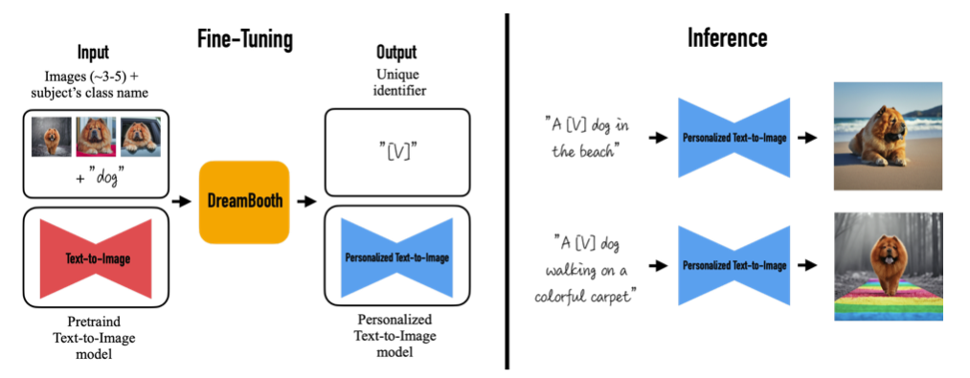
Dreambooth
Ruiz, Nataniel, et al. "Dreambooth: Fine tuning text-to-image diffusion models for subject-driven generation."
Notes:
introduces a method to personalize text-to-image diffusion models, allowing them to synthesize novel images of a subject from a few reference images. By fine-tuning a pretrained model to associate a unique identifier with the subject, the model can generate photorealistic images of the subject in various contexts not seen in the reference set. Leveraging a new autogenous class-specific prior preservation loss enables diverse synthesis of the subject across different scenes, poses, views, and lighting conditions while preserving key features.

Slide 12
LoRA
Hu, Edward J., et al. "Lora: Low-rank adaptation of large language models."
First introduced for LLMs, and later proposed by Simo Ryu for diffusion models
Proposes to freeze pre-trained model weights and inject trainable layers in transformer blocks
Quality on par with full fine-tuning while being faster & needing less compute
https://github.com/cloneofsimo/lora
Notes:
1. LoRA: Low-Rank Adaptation of Large Language Models is a novel technique introduced by Microsoft researchers to deal with the problem of fine-tuning large-language models. 2. LoRA proposes to freeze pre-trained model weights and inject trainable layers (rank-decomposition matrices) in each transformer block. This greatly reduces the number of trainable parameters and GPU memory requirements since gradients don't need to be computed for most model weights. 3.The researchers found that by focusing on the Transformer attention blocks of large-language models, fine-tuning quality with LoRA was on par with full model fine-tuning while being much faster and requiring less compute. Even though LoRA was initially proposed for large-language models and demonstrated on transformer blocks, the technique can also be applied elsewhere. In the case of Stable Diffusion fine-tuning, LoRA can be applied to the cross-attention layers that relate the image representations with the prompts that describe them. The details of the following figure (taken from the Stable Diffusion paper) are not important, just note that the yellow blocks are the ones in charge of building the relationship between image and text representations.

Slide 13
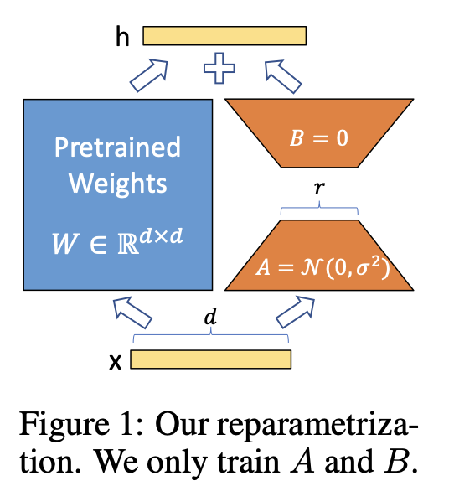
LoRA
LoRA: Low-Rank Adaptation of Large Language Models
For a pre-trained weight matrix W0, LoRA decomposes its update into W0 + ∆W and represents ∆W as a product of two low-rank matrices, B and A. Both B and A have ranks significantly smaller than the dimensions of W0, dramatically reducing the number of trainable parameters.
Hu, Edward J., et al. "Lora: Low-rank adaptation of large language models."

Slide 14
Recap
 | Output
Dreambooth | Fine tuned model
LoRA | Injectable layers
Textual Inversion | Text embeddings

Slide 15
Let’s Train 🚀

Slide 16

What if we combine
Dreambooth
with LoRA?

Slide 17
Recap
 | Output
Dreambooth | Fine tuned model
LoRA | Injectable layers
Textual Inversion | Text embeddings
Dreambooth LoRA | Injectable layers

Slide 18
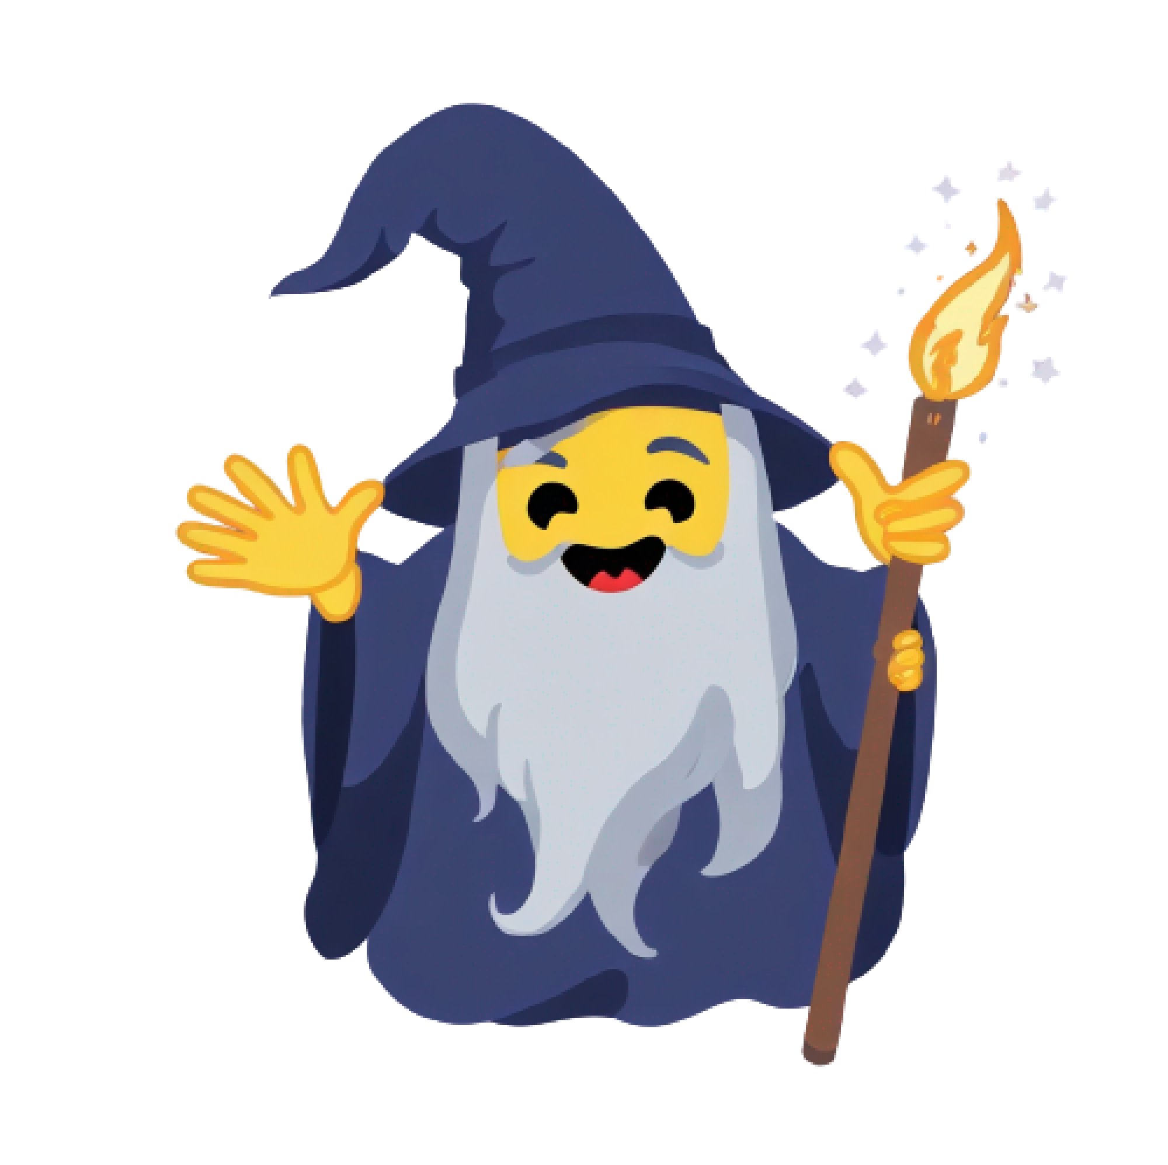
What if #2: We add in Textual inversion?

Slide 19
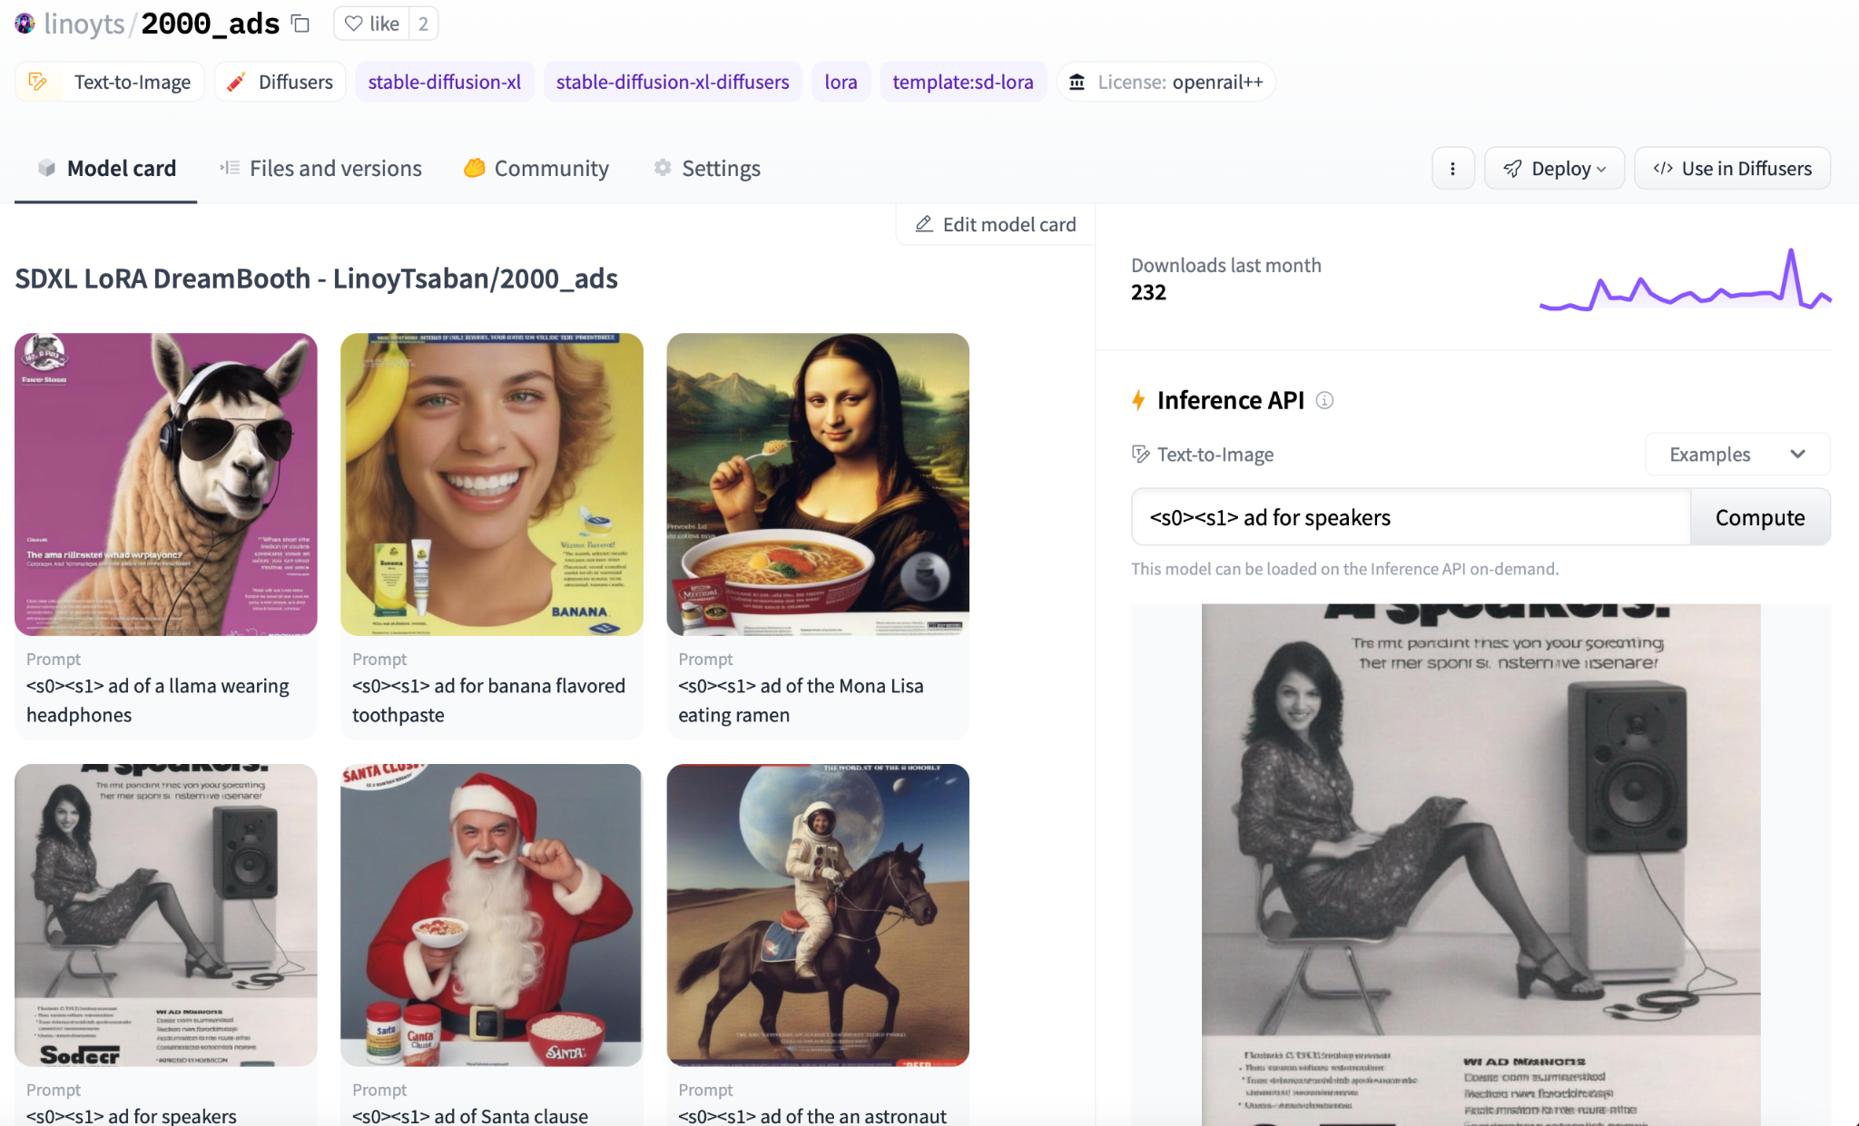
Share your models with the community!🚀

Slide 20
Pivotal Tuning
Pivotal Tuning
(Fine Tuning Technique)
combines Textual Inversion with regular diffusion fine-tuning by inserting new tokens into the text encoders of the model, instead of reusing existing ones and optimize the associated embeddings. We continue to fine-tune the LoRA layers of the unet with the new textual embeddings.
Notes:
combines Textual Inversion with regular diffusion fine-tuning. For Dreambooth, it is customary that you provide a rare token to be your trigger word, say "an sks dog". However, those tokens usually have other semantic meaning associated with them and can affect your results. The sks example, popular in the community, is actually associated with a weapons brand.
To tackle this issue, we insert new tokens into the text encoders of the model, instead of reusing existing ones. We then optimize the newly-inserted token embeddings to represent the new concept: that is Textual Inversion – we learn to represent the concept through new "words" in the embedding space. Once we obtain the new token and its embeddings to represent it, we can train our Dreambooth LoRA with those token embeddings to get the best of both worlds.

Slide 21
Recap
 | Output
Dreambooth | Fine tuned model
LoRA | Injectable layers
Textual Inversion | Text embeddings
Dreambooth LoRA | Injectable layers
Dreambooth LoRA with Pivotal Tuning | Injectable layers & text embeddings

Slide 22
Learn More 🤗
🎬Introduction to Diffusion Models:
Hugging Face Diffusion Models Course
💌Blog Posts:
Blog post about Dreambooth
Blog post about LoRAs
Blog post about current SOTA practices for Dreambooth LoRA
📚Useful Docs:
Dreambooth with Diffusers
Textual Inversion with Diffusers LoRA with Diffusers

Slide 23
Personalization Playground
Demos worth trying🔥
▶️ LoRA Studio
▶️ LoRA the explorer ▶️ LoRA roulette
▶️ IP Adapter
▶️ Instant ID

Slide 24
Thank You!

